Slide 1
Introduction to scientific programing – Python
Python Basics:
Data Types, Lists & List Operations, Conditionals
Materials provided by Daniel Platero-Rochart

Slide 2

Data Types
Strings
It is handled using the str object and are immutable sequences of Unicode code points (UTF-8).

Slide 3
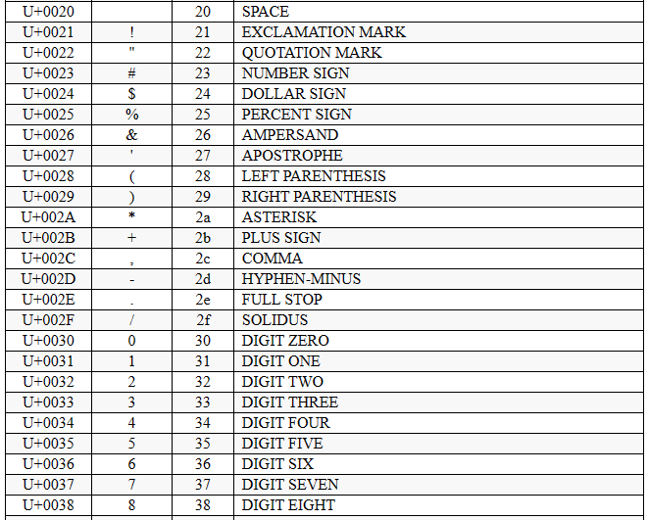
Data Types
Strings
It is handled using the str object and are immutable sequences of Unicode code points (UTF-8).

Slide 4
Data Types
Strings
It is handled using the str object and are immutable sequences of Unicode code points (UTF-8).
text1 = ‘This is a string’
text2 = “This is also a string”

Slide 5
Data Types
Strings
It is handled using the str object and are immutable sequences of Unicode code points (UTF-8).
text1 = ‘This is a string’
text2 = “This is also a string”
text3 = ‘‘‘This is a
multiline string’’’
text4 = “““This is too a
multiline string”””

Slide 6
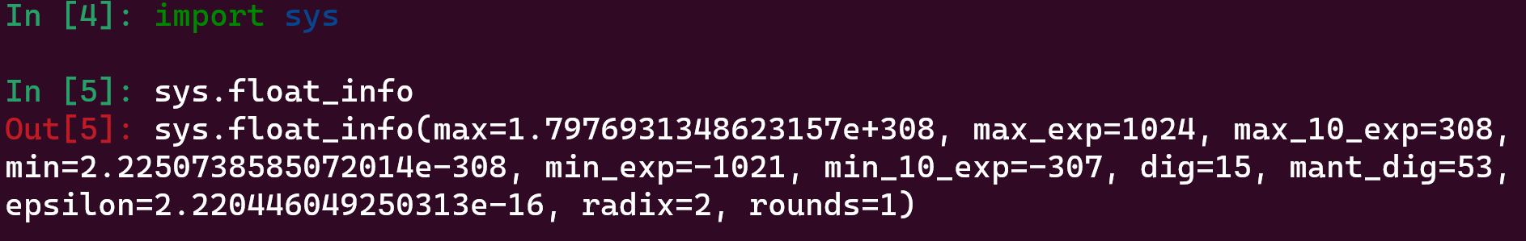
Data Types
Numeric values
Python has three different numeric values: integers, floating point, and complex numbers. In addition, Booleans can be used as integers (subtype).
a = int(42) # unlimited precision (limited only by memory)
a = float(42.5) # implemented using double in C (sys.float_info)

Slide 7
Data Types
Numeric values
Python has three different numeric values: integers, floating point, and complex numbers. In addition, Booleans can be used as integers (subtype).
a = complex(1, -3) # contain a real (re) and imaginary part (im), both of them can be float values
print(a)
(1-3j)
a.real
>>> 1
a.imag
>>> -3

Slide 8
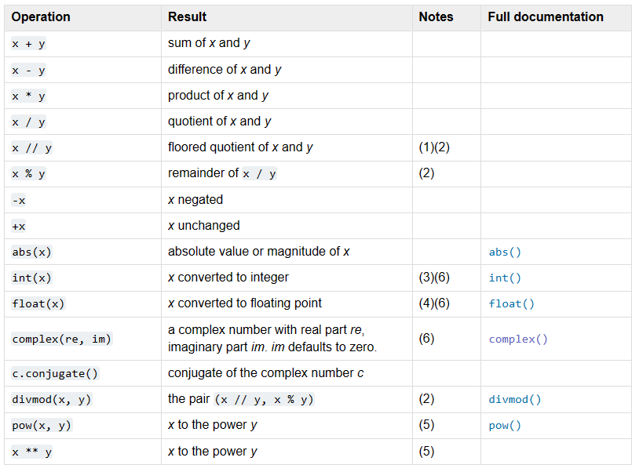
Data Types

Slide 9
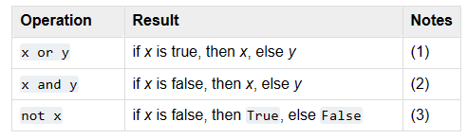
Data Types
Booleans
True (1) or False (0).

Slide 10
Data Structures
Lists
Use to store collections of homogeneous or heterogeneous items.
a = []
a = list()
a.append() # append 4 to the list
a.extend(iterable) # extend the list using an iterable
a.remove() # remove ‘2’ from the list
a.reverse() # reverse the order of the list
a.sort() # sort the list

Slide 11
Data Structures
Lists
Use to store collections of homogeneous or heterogeneous items.
min() # find the minimum value
max() # find the maximum value
len() # number of elements in the list
sum() # sum the values in the list

Slide 12
Data Structures
Sets
Unordered collection of data. Do not support indexing or slicing. Commonly used to test membership, remove duplicates, and mathematical operations like union, intersection etc.
a = set()
a = {}
a.add()
a.remove()
min(a)
max(a)

Slide 13
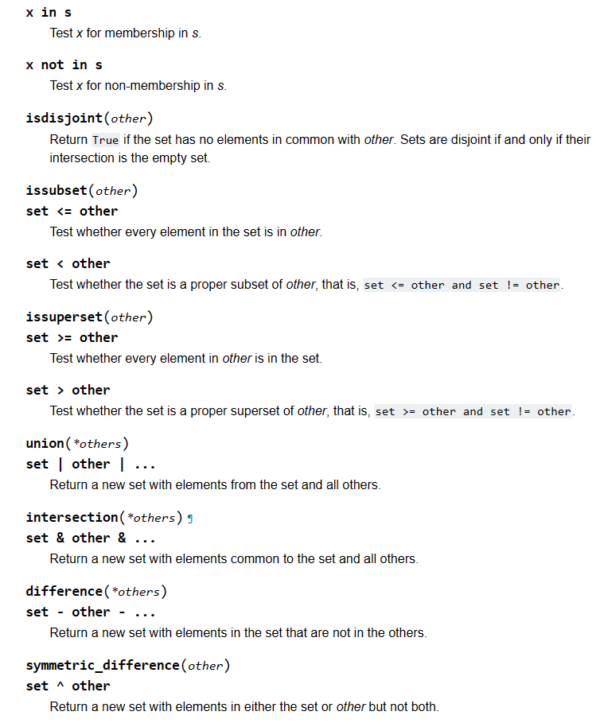
Data Structures

Slide 14
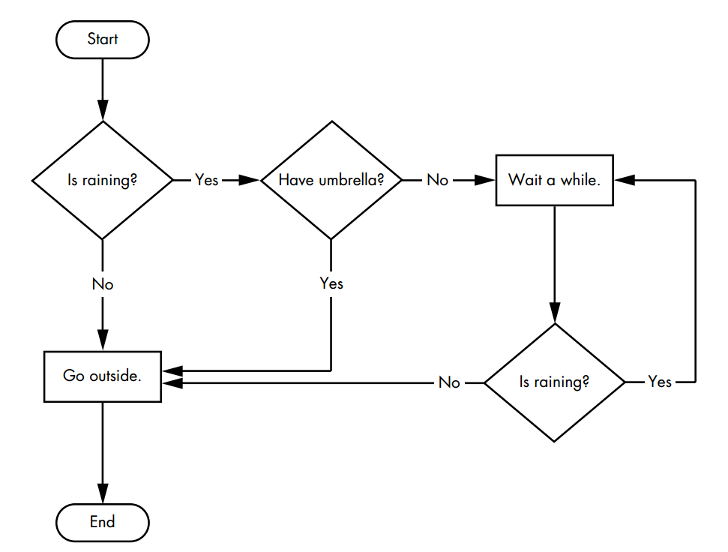
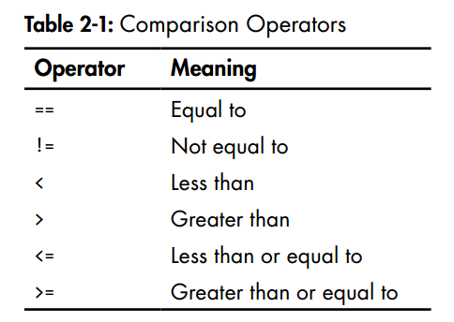
Conditions

Slide 15
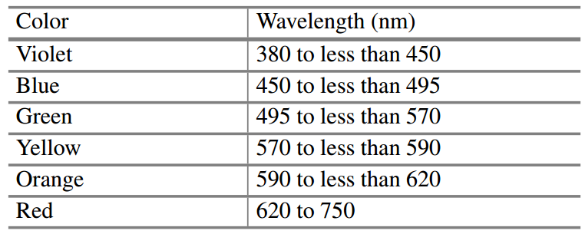
Conditions
Exercise 2:
Create a program that returns the roots of a Quadratic function.
Exercise 3:
Create a program that returns the color of a given wavelength in the visible light range.

Slide 16
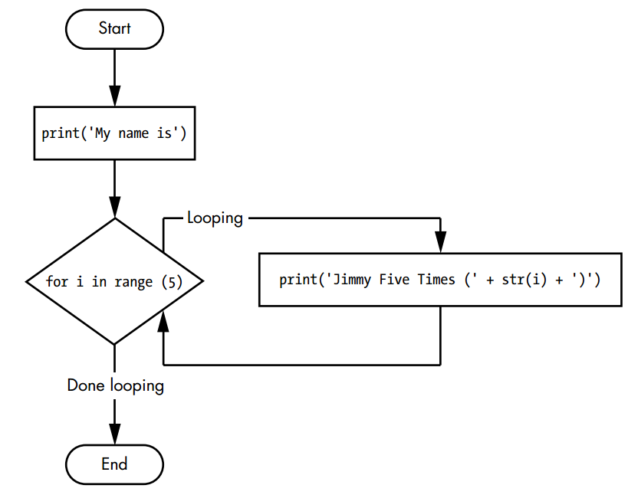
Looping

Slide 17
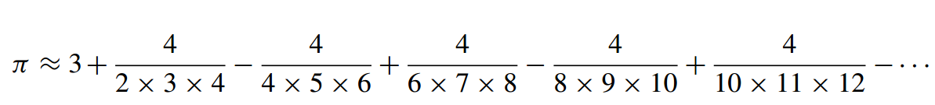
Looping
Exercise 4:
Create a program that returns pi approximations
Exercise 5:
Create a program that returns prime numbers up to a certain value.

Slide 18
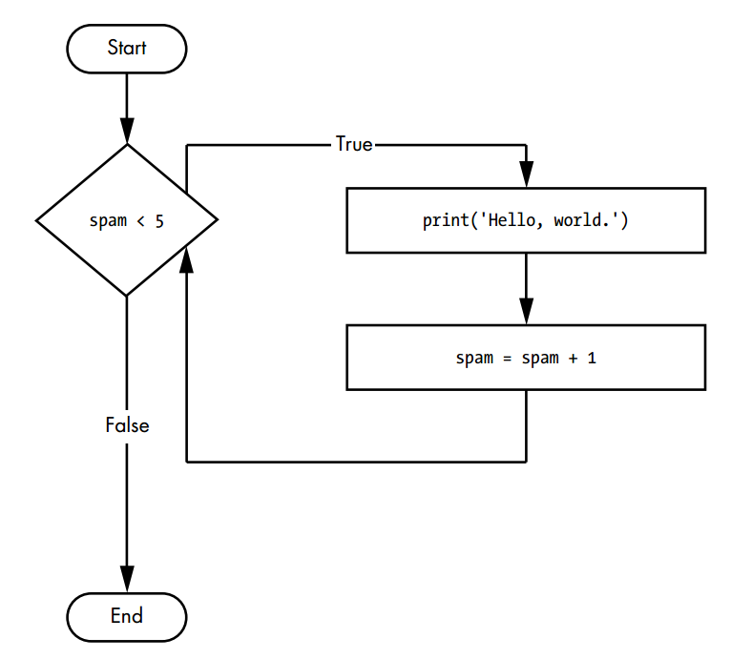
Looping

Slide 19
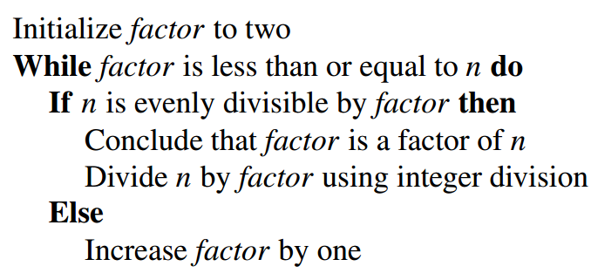
Looping
Exercise 6:
Create a program that returns the square root using Newton’s method
Exercise 7:
Create a program that returns the prime factorization of any number.

Slide 20
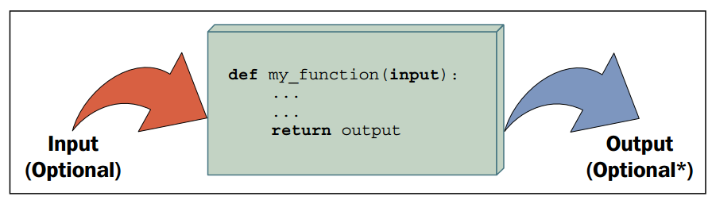
Functions

Slide 21
Automate the boring stuff with Python. Practical Programming for total beginners. Al Sweigart.
Learning Python. Fabrizio Romano.
The Python Workbook. A brief introduction with exercises and solutions. Ben Stephenson.

Slide 22
Further Resources:
https://developers.google.com/edu/python - Google’s 2-day Python Course
Automate the boring stuff with Python. Practical Programming for total beginners. Al Sweigart.
Learning Python. Fabrizio Romano.
The Python Workbook. A brief introduction with exercises and solutions. Ben Stephenson.
https://wiki.python.org/moin/BeginnersGuide/NonProgrammers

Slide 23

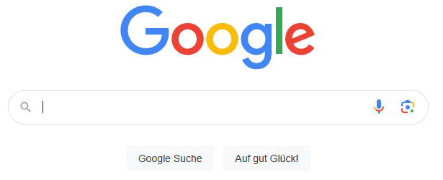
Further Resources:
Automate the boring stuff with Python. Practical Programming for total beginners. Al Sweigart.
Learning Python. Fabrizio Romano.
The Python Workbook. A brief introduction with exercises and solutions. Ben Stephenson.
https://wiki.python.org/moin/BeginnersGuide/NonProgrammers
REMEMBER: Problem-solving is the key to understanding!
Before getting an easy answer, give it your
best try!
Embrace challenges—that is how you
learn and grow ☺
ChatGPT

